Slide 1
Shape Shifting Technology
Atibhav Mittal
Spring 2016
CS 35L Assignment 10

Slide 2
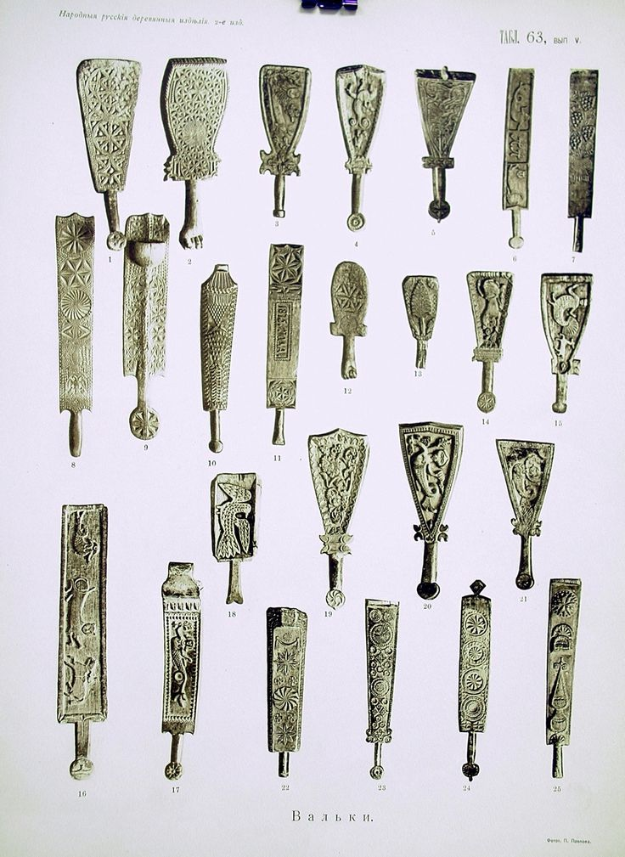
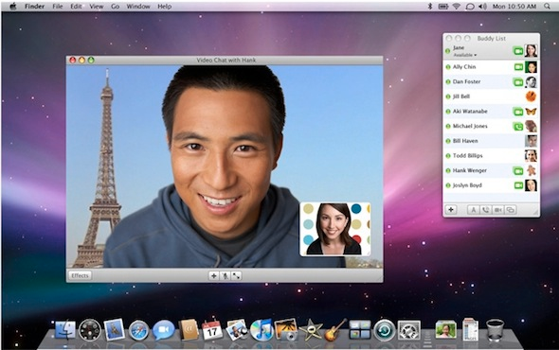
History of Tools
Man started out by wooden tools
Computers Developed
Still not interact-able
Still a 2D world that we experience on computers

Slide 3
What is Shape Shifting Technology?
Gives us a completely new interface
Ability to remotely interact with objects
Uses an inFORM surface that can be interacted with by touch and various other ways

Slide 4
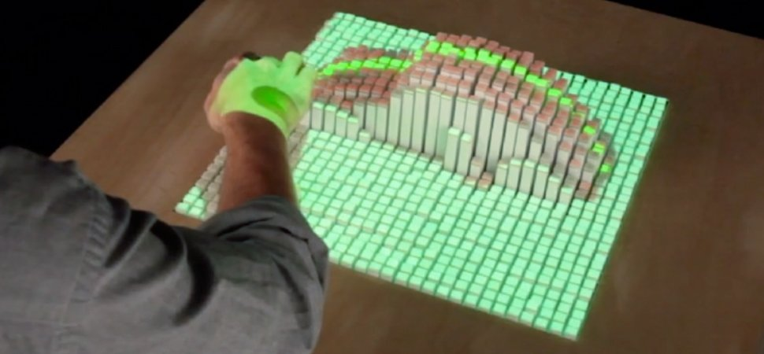
inFORM Platforms
Being developed by Sean Follmer at Stanford
Made out of linear actuators
Allows us to interact with objects in real time

Slide 5

Shape Shifting Fluid Robots
Non Newtonian Fluids: Viscosity Changes
Carry Stuff up to 5 times their weight
Can break down into smaller blobs
Resistant to scratches
Can do things that current robots cannot

Slide 6
Applications of Shape Shifting Technology
Urban Planning
Robots using Shape-Shifting fluids
Ability to control and interact with objects in real time

Slide 7
Shortcomings of Current Technology
inFORM surface is clunky
inFORM surface does not simulate real objects
Fluid Robots can only be used on an “sound generating platforms”

Slide 8
Bibliography
"Shape-shifting Tech Will Change Work as We Know It | Sean Follmer." YouTube. YouTube, 01 Mar. 2016. Web. 17 May 2016 https://www.youtube.com/watch?v=8sheoGMsy3Q
"Researchers Are Developing Shape-Shifting Fluid Robots." Inside Science. N.p., 19 Feb. 2016. Web. 17 May 2016. https://www.insidescience.org/content/researchers-are-developing-shape-shifting-fluid-robots/3686
Images:
https://www.pinterest.com/pin/349803096033944798
https://www.flickr.com/photos/rexboggs5/6107704756/sizes/l

